Slide 1
The International Image Interoperability Framework (IIIF)
Peter Stokes
peter.stokes@ephe.psl.eu

Slide 2
IIIF Image API https://iiif.io/api/presentation/2.1/

Slide 3
IIIF Image Request URI Syntax
‘The IIIF Image API URI for requesting an image must conform to the following URI Template:
{scheme}://{server}{/prefix}/{identifier}/{region}/{size}/{rotation}/{quality}.{format} For example:
http://www.example.org/image-service/abcd1234/full/full/0/default.jpg ‘
‘The parameters of the Image Request URI include region, size, rotation, quality and format, which define the characteristics of the returned image. These are described in detail in Image Request Parameters.’
https://iiif.io/api/image/2.1/#image-request-uri-syntax

Slide 4
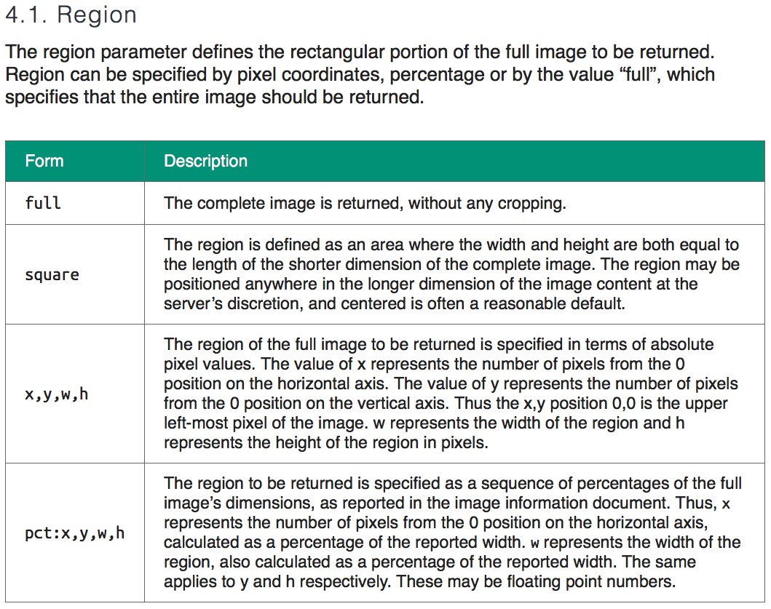

Slide 5
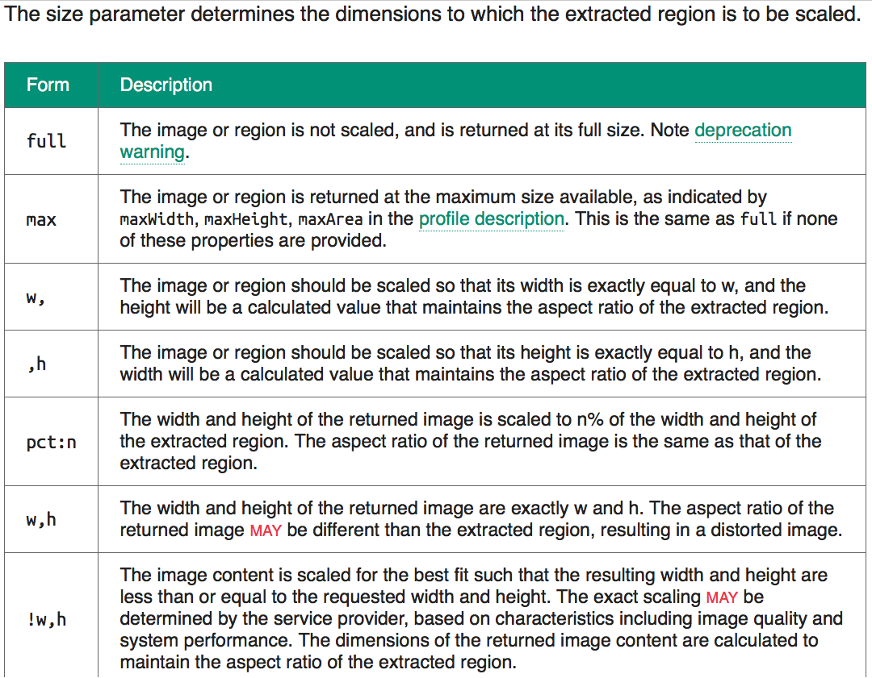

Slide 6
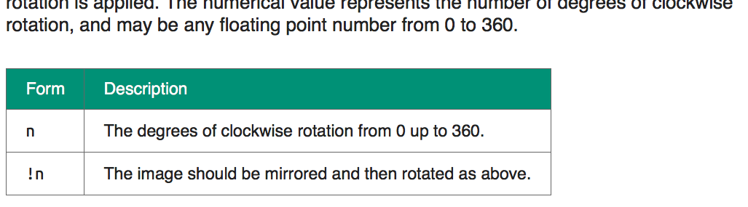
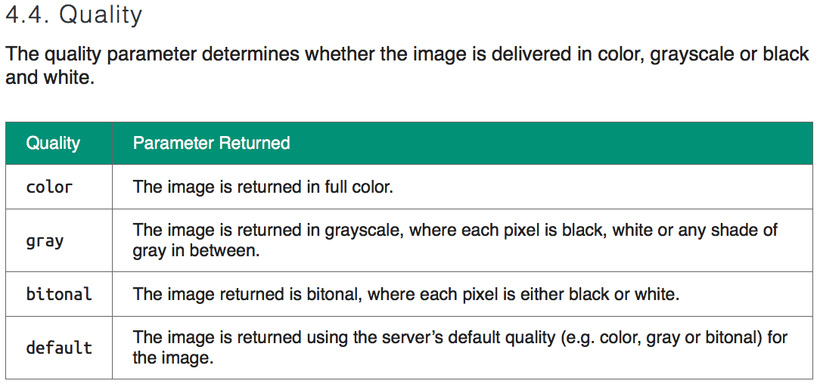

Slide 7
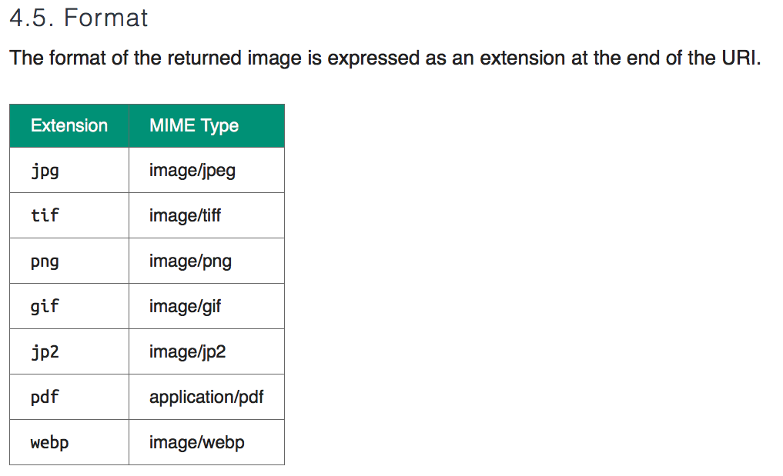

Slide 8
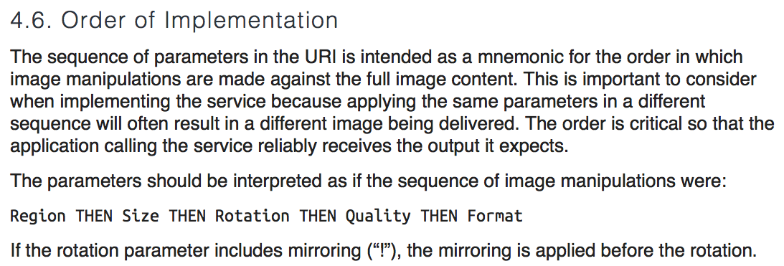

Slide 9
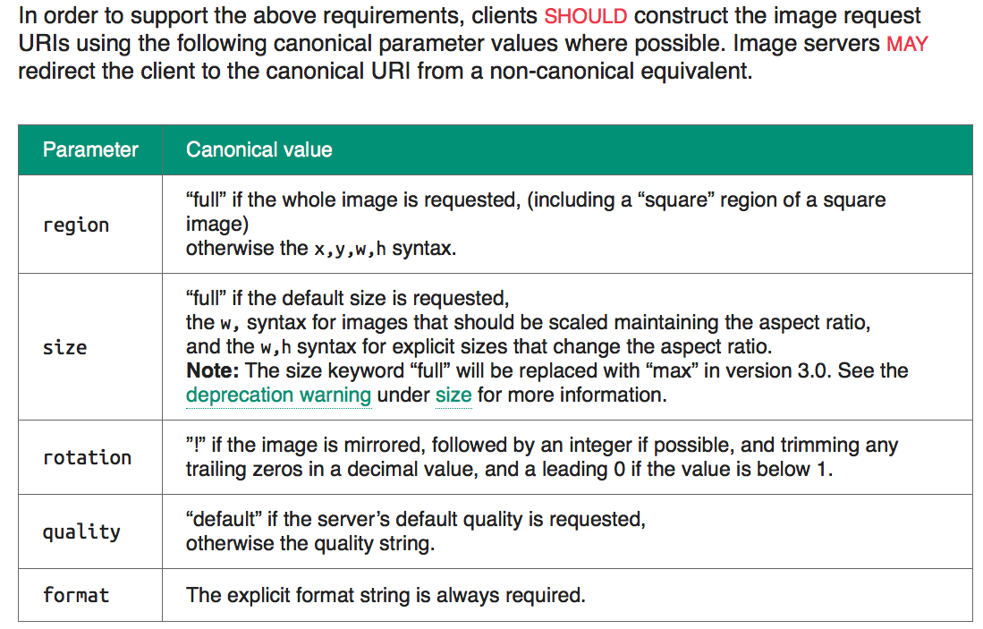

Slide 10
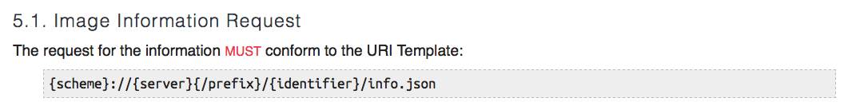
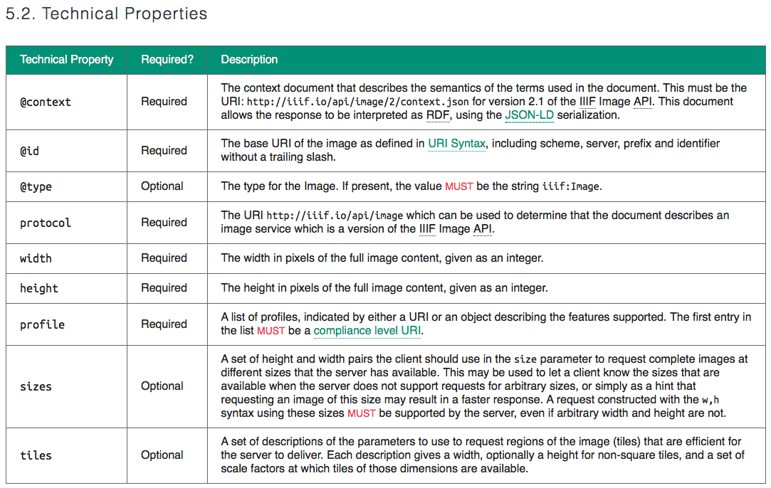

Slide 11
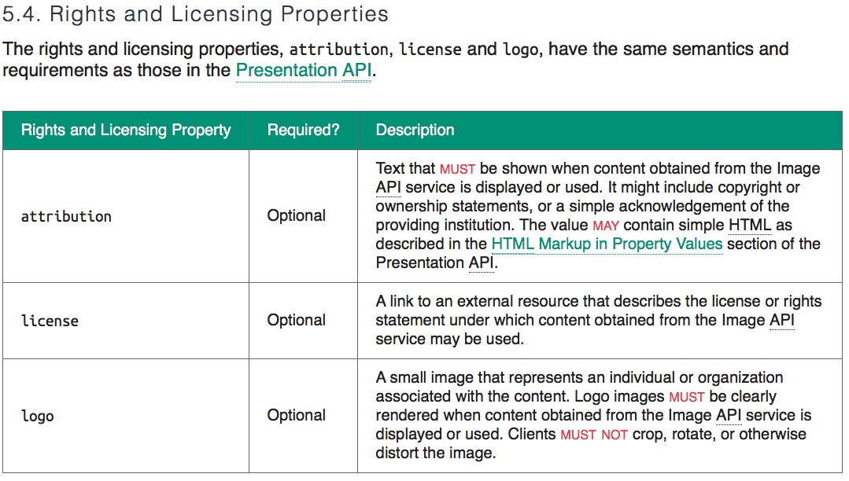

Slide 12
IIIF Presentation API https://iiif.io/api/presentation/2.1/

Slide 13
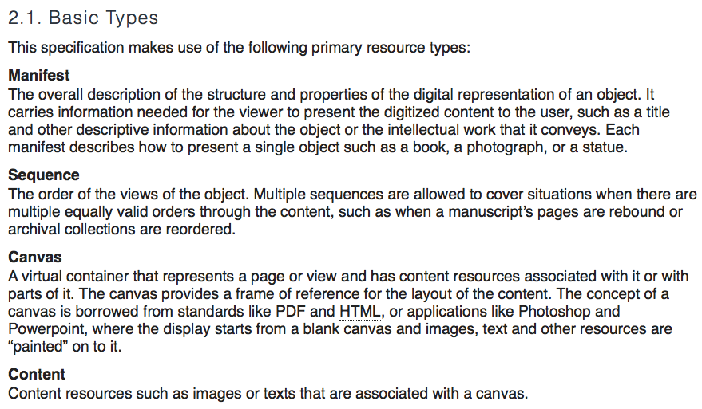

Slide 14
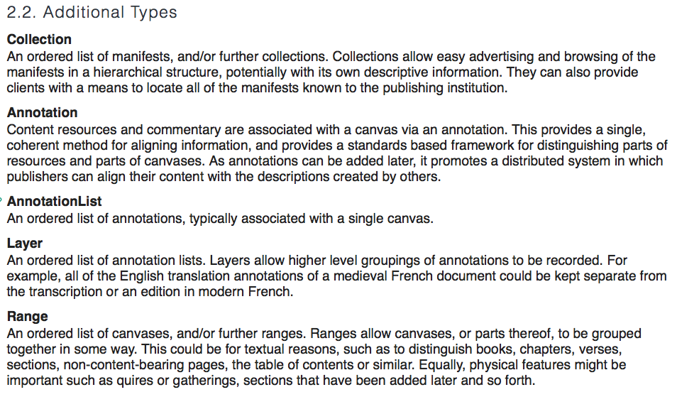

Slide 15
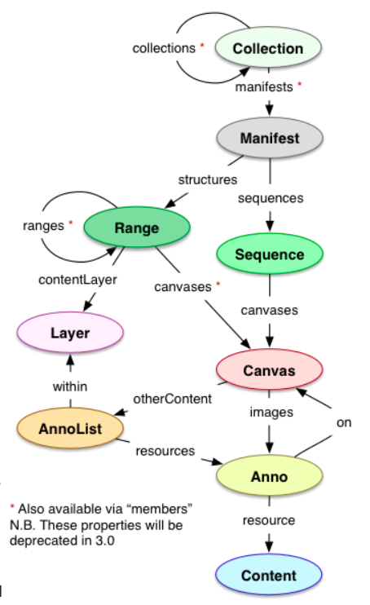
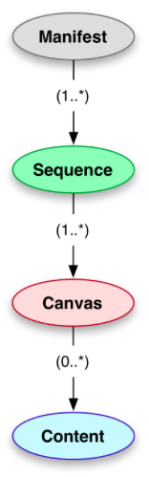

Slide 16
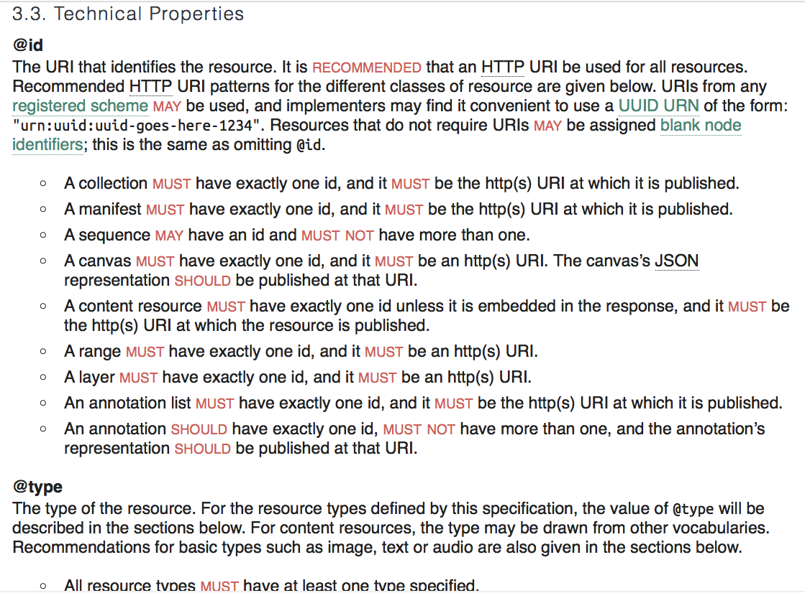

Slide 17
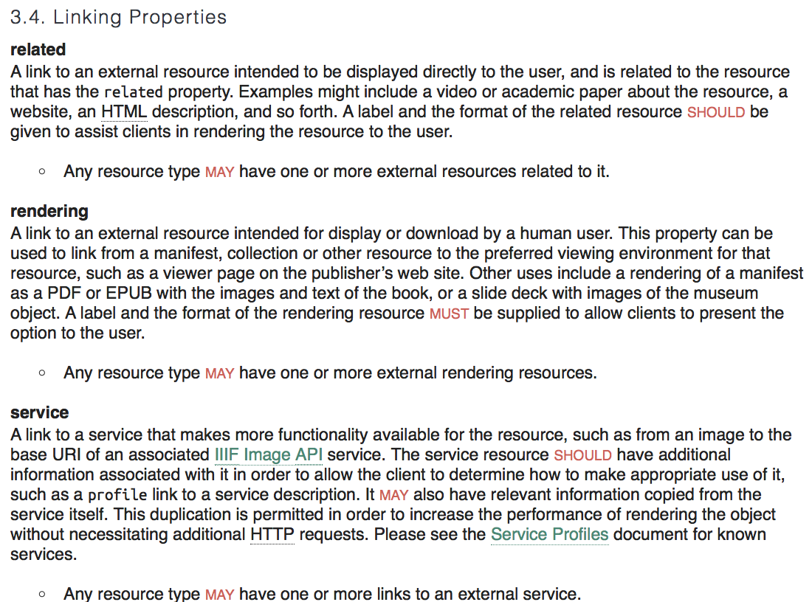

Slide 18
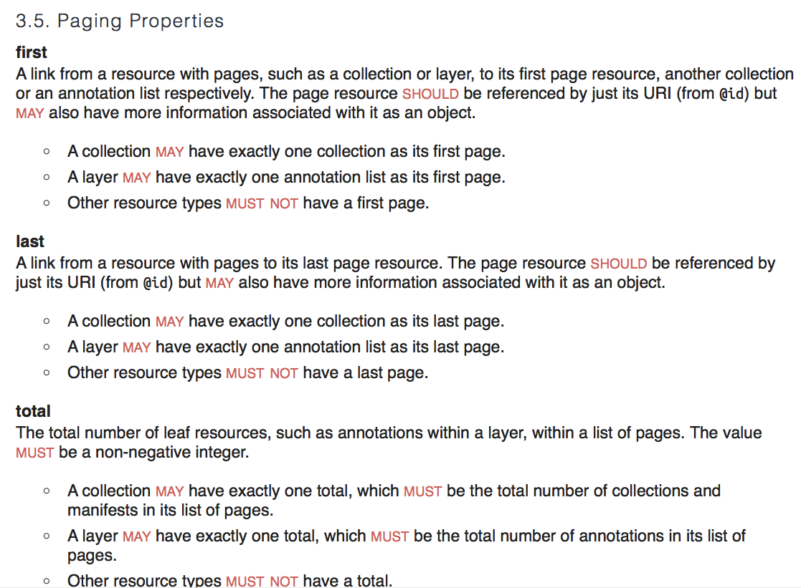

Slide 19
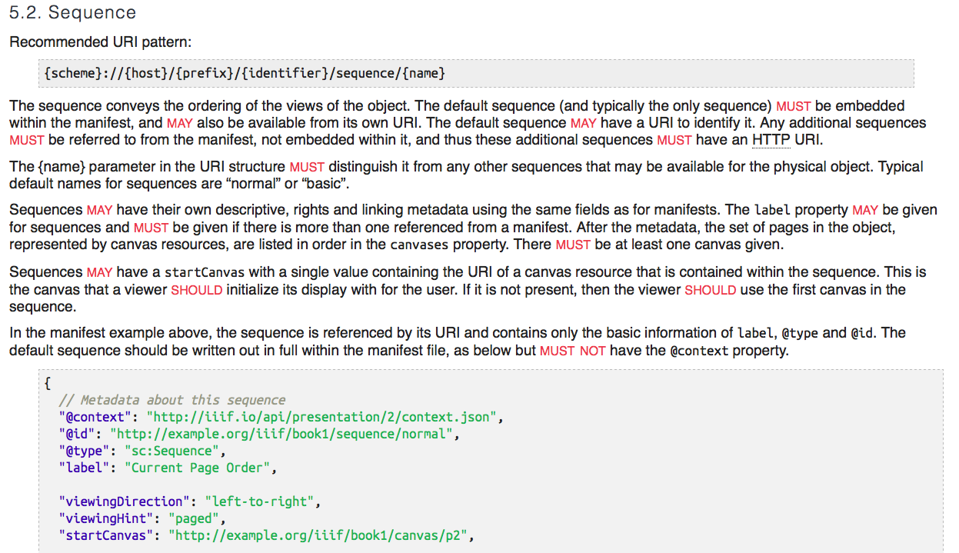

Slide 20
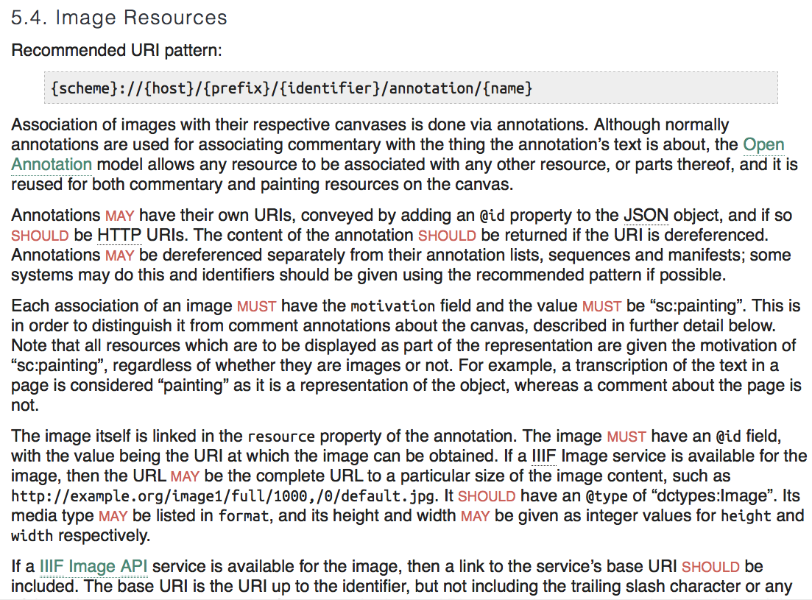

Slide 21
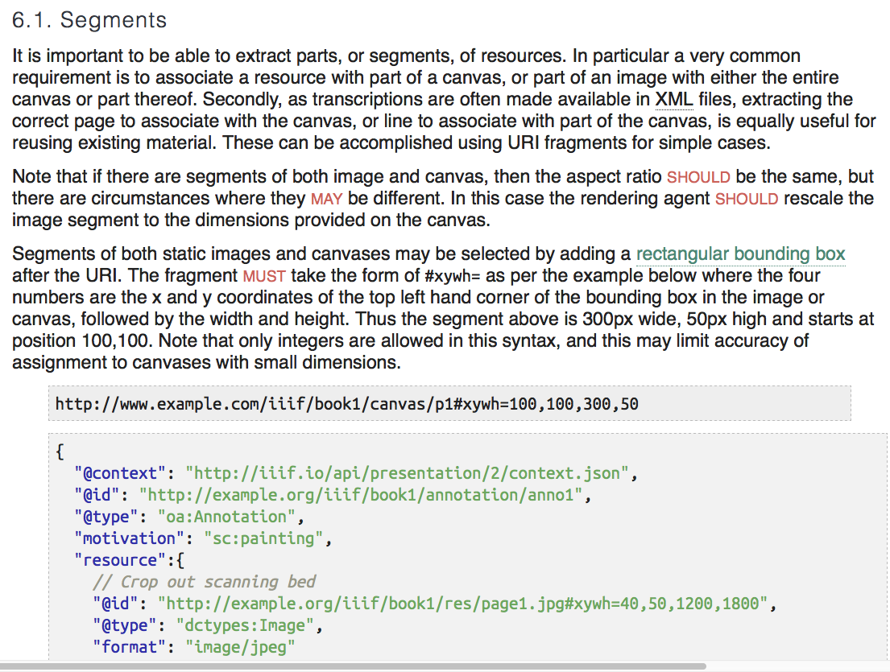

Slide 22
Examples
https://iiif.biblissima.fr/collections/
Cambridge, Corpus Christi College: https://dms-data.stanford.edu/data/manifests/Parker/collection.json
E-Codices: http://www.e-codices.unifr.ch/metadata/iiif/sbs-0001/manifest.json
Oxford, Bodleian Library: https://iiif.bodleian.ox.ac.uk/iiif/collection/top
Fragmentarium : https://fragmentarium.ms/metadata/iiif/collection.json
Etc…
https://github.com/bodleian/iiif-manifest-editor

